Slide 1



Lowndes County by the Numbers
How Do We Compare with Peer and Aspirant Communities?
2012 Report

Slide 2
Purpose of the report
Use benchmarks to assess economic performance against peer and aspirant communities
Provide an objective foundation for developing strategic planning and growth strategies

Slide 3
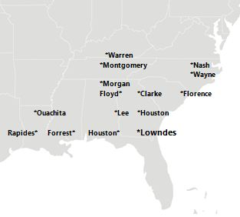
Peer and Aspirant Communities

Slide 4
Identify Benchmarks
People Indicators
Educational Attainment
Job Indicators
Private Jobs
Desired Outcomes
Economic Growth
Population Growth
Knowledge Jobs
Unemployment rate
Average Weekly Wage
Median Income
Poverty Rate
Economic Prosperity
Old Age Dependency

Slide 5
The Region over Time
How we compare to the Peer and Aspirant community average, the Southeast region, and the United States

Slide 6
People Indicators over time
Reflect the demographic foundations of the communities and
Measure how well-prepared the people in the community are for work.

Slide 9
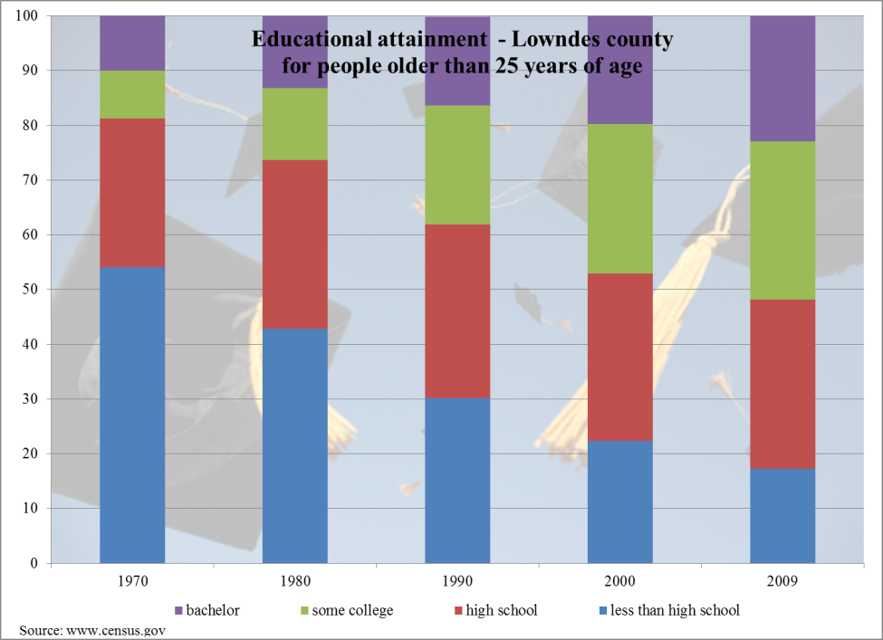

Slide 11
Job Indicators over time
Reflect the workforce foundations of the communities.

Slide 20
The Region Today
How we compare with
Peer and Aspirant Communities

Slide 21
People Indicators
reflect the demographic foundations of the communities and
measure how well-prepared the people in the community are for work.
People Indicators
  Educational Attainment
  Population Growth
  Poverty Rate
  Old Age Dependency

Slide 22
People Indicators
Average: 13.3%
Notes:
Avg growth rate higher than last year. Lowndes rank did not change but pop growth rate is higher.

Slide 23
People Indicators
Average: 83.1%
Notes:
Lowndes rank remained 8th. Graduation rate improved slightly from 82.7%

Slide 24
People Indicators
Average: 23.3%
Notes:
Lowndes rank did not change however the % with Bachelor degrees declined slightly from 22.9%

Slide 25
People Indicators
Average: 20.4%
Notes:
Rank improved from 14th to 13th. Poverty rate declined slightly from 23.6%. Forrest, MS increased from 23.1%

Slide 26
People Indicators
Average: 18.8%
Notes:
Although the percent declined from 17.3% to 16.9%, Lowndes rank declined from 3rd to 5th.

Slide 27
People Indicators
Notes:
Lowndes overall rank for People Indicators did not change.

Slide 28
Job Indicators
Indicators that reflect the workforce foundations of the communities.
Job Indicators
  Private Jobs
  Knowledge Jobs
  Unemployment rate
  Median Income
  Average Weekly Wage

Slide 29
Job Indicators
Average: 38,072
Notes:
Rank did not change however the number of private sector jobs declined from 36,436 to 35,216

Slide 30
Job Indicators
Average: $40,516
Median Income: A measure of household purchasing power from all sources of income
Notes:
Median Income declined from $38,143 to $36,486 and rank declined from 11 to 13.

Slide 31
Job
Indicators
Average: $644
Notes:
Lowndes weekly wage improved from $551 to $561 and rank increased from 15 to 14.

Slide 32
Job Indicators
Average: 23.9%
Knowledge-based sector jobs: NAICS numbers for Information (51), Professional, Scientific, & Technical Services (54), Management of Companies & Enterprises (55), and Health Care and Social Assistance (62).
Notes:
Rank improved from 13 to 10 and percent increased from 19.0% to 21.2%

Slide 33
Job Indicators
Average: $814
Notes:
Knowledge sector avg weekly wage declined from $739 to $735 and rank declined from 11 to 13. Overall Avg wage increased from $796 to $814

Slide 34
Job Indicators
Average: 9.1%
Notes:
Unemployment rate higher. 8.1% to 8.8%. Rank declined from 6 to 7.

Slide 35
Job Indicators

Slide 36
Overall Standing
People Indicators standing
+
Job Indicators standing

Slide 37
Overall Standing

Slide 38
Lowndes County by the Numbers
How Do We Compare with Peer and Aspirant Communities?
2012 Report

